Slide 1
24
7
30
Date
Pythagoras Theorem
EQ – How do I find the shorter side?

Slide 2
What is a right triangle?
hypotenuse
leg
right angle
leg
It is a triangle which has an angle that is 90 degrees.
The two sides that make up the right angle are called legs.
The side opposite the right angle is the hypotenuse.

Slide 3
The lengths of the legs are usually called a and b.
a
b

Slide 4
The side across from the right angle
is called the
hypotenuse.
a
b

Slide 5
And the length of the hypotenuse is usually labeled c.
c
a
b

Slide 6
The relationship Pythagorus discovered is now called The Pythagorean Theorem:
c
a
b

Slide 7
The Pythagorean Theorem says, given the right triangle with legs a and b and hypotenuse c,
c
a
b

Slide 8
then
c
a
b

Slide 9
Pythagoras’s Theorem
c
b
a

Slide 10





Pythagoras Theorem is about right angles triangles.
$c$
$a$
$b$
$$a^{2}+ b^{2}= c^{2}$$
Therefore to find the shorter sides (legs):
$${ a}^{2}=c^{2}−b^{2} and b^{2}=c^{2}−a^{2}$$
$a= \sqrt{c^{2}− b^{2} }$
$$b=\sqrt{c^{2}− a^{2}}$$
$$c=\sqrt{a^{2}+ b^{2}}$$
5

Slide 11


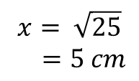
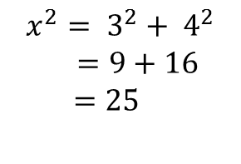

Examples
$$x$$
$$3 cm$$
$$4 cm$$
$$x^{2}= 3^{2}+ 4^{2}$$
$=9+16$
$$=25$$
$$x= \sqrt{25}$$
$=5 cm$

Slide 12


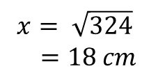
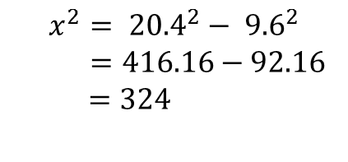

Examples
$$9.6 cm$$
$$x$$
$$x^{2}= {20.4}^{2}− {9.6}^{2}$$
$=416.16−92.16$
$$=324$$
$$20.4 cm$$
$$x= \sqrt{324}$$
$=18 cm$

Slide 13
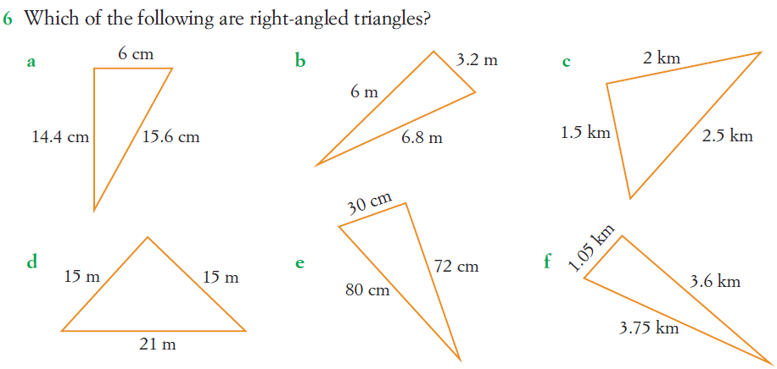
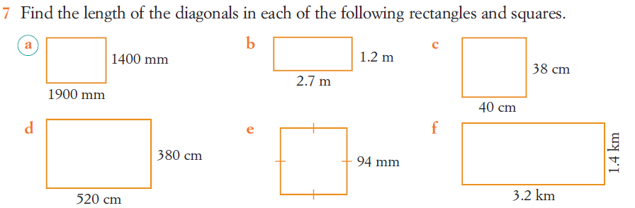
Questions

Slide 14
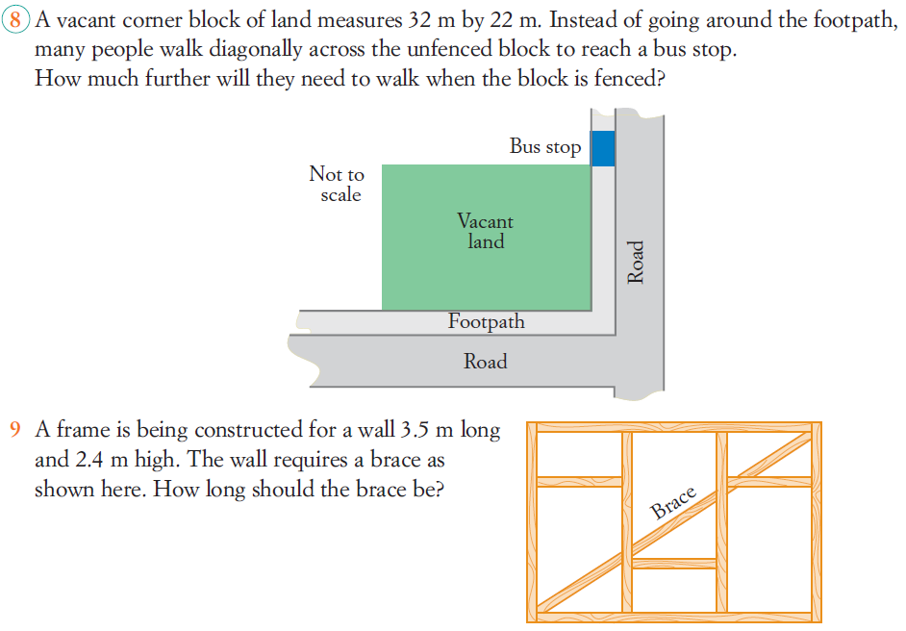
Questions

Slide 15
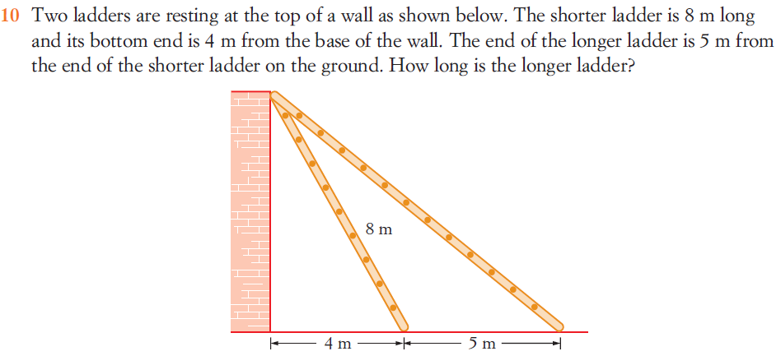
Questions

Slide 16
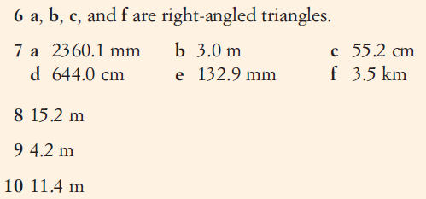

Answers

Slide 17
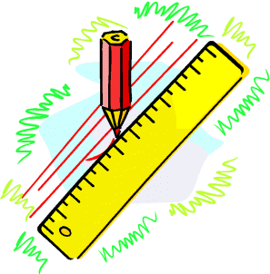
Solving Real-Life Problems
Problem : Find the length of h.
B
h
C
15
12
A
D
13

Slide 18
Solving Real-Life Problems
Problem : Find the length of h.
Answer:
Find length BD first
B
h
C
15
12
A
D
13

Slide 19
Solving Real-Life Problems
Problem : Find the length of length h.
Now find h
B
h
C
15
12
A
D
13

Slide 20
Solving Real-Life Problems
Problem : Find the diagonal length of the cuboid AG.
F
G
B
C
7cm
E
H
6cm
A
D
8cm

Slide 21
Solving Real-Life Problems
Problem : Find the diagonal length of the cuboid AG.
Answer:
Find AH first
F
G
B
C
7cm
E
H
10cm
6cm
A
D
8cm

Slide 22
Solving Real-Life Problems
Problem : Find the diagonal length of the cuboid AG.
Now find AG
F
G
B
C
7cm
E
H
10cm
6cm
A
D
8cm

